Slide 1
Parallel Programming in C with MPI and OpenMP
Michael J. Quinn

Slide 2
Chapter 1
Motivation and History

Slide 3
Outline
Motivation
Modern scientific method
Evolution of supercomputing
Modern parallel computers
Seeking concurrency
Data clustering case study
Programming parallel computers

Slide 4
Why Faster Computers?
1.1
Solve compute-intensive problems faster
  Make infeasible problems feasible
  Reduce design time
Solve larger problems in same amount of time
  Improve answer’s precision
  Reduce design time
Gain competitive advantage

Slide 5
Definitions
1.1
Parallel computing
  Using parallel computer to solve single problems faster
Parallel computer
  Multiple-processor system supporting parallel programming
Parallel programming
  Programming in a language that supports concurrency explicitly

Slide 6
Why MPI?
1.1
MPI = “Message Passing Interface”
Standard specification for message-passing libraries
Libraries available on virtually all parallel computers
Free libraries also available for networks of workstations or commodity clusters

Slide 7
Why OpenMP?
1.1
OpenMP an application programming interface (API) for shared-memory systems
Supports higher performance parallel programming of symmetrical multiprocessors

Slide 8
Classical Science
1.2
Nature
Observation
Physical
Experimentation
Theory

Slide 9
Modern Scientific Method
1.2
Nature
Observation
Numerical
Simulation
Physical
Experimentation
Theory

Slide 10
Evolution of Supercomputing
1.3
World War II
  Hand-computed artillery tables
  Need to speed computations
  ENIAC
Cold War
  Nuclear weapon design
  Intelligence gathering
  Code-breaking

Slide 11
Supercomputer
1.3
General-purpose computer
Solves individual problems at high speeds, compared with contemporary systems
Typically costs $10 million or more
Traditionally found in government labs

Slide 12
Commercial Supercomputing
1.3
Started in capital-intensive industries
  Petroleum exploration
  Automobile manufacturing
Other companies followed suit
  Pharmaceutical design
  Consumer products

Slide 13

50 Years of Speed Increases
1.3
Today
> 1 trillion flops
One Billion Times Faster!
ENIAC
350 flops

Slide 14
CPUs 1 Million Times Faster
1.3
Faster clock speeds
Greater system concurrency
  Multiple functional units
  Concurrent instruction execution
  Speculative instruction execution

Slide 15
Systems 1 Billion Times Faster
1.3
Processors are 1 million times faster
Combine thousands of processors
Parallel computer
  Multiple processors
  Supports parallel programming
Parallel computing = Using a parallel computer to execute a program faster

Slide 16
Microprocessor Revolution
1.3
Speed (log scale)
Micros
Supercomputers
Moore's Law
Mainframes
Minis
Time

Slide 17
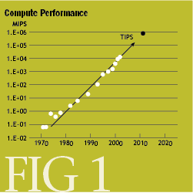
1.3
http://www.acmqueue.org/figures/issue007/borkarfig1.gif

Slide 18
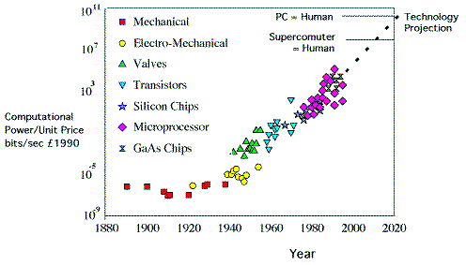
1.3
http://www.cochrane.org.uk/opinion/papers/images/exponentialeducation4.gif

Slide 19
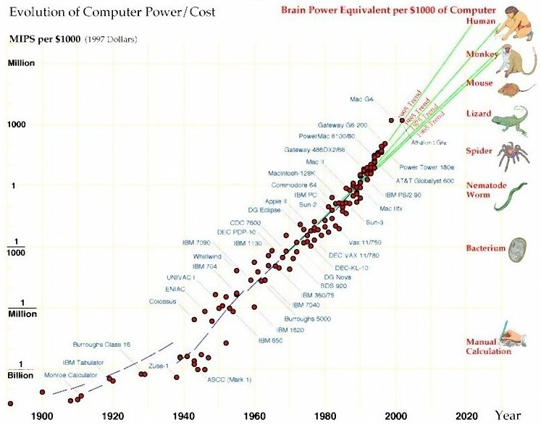
1.3
http://www.rubbertreeplant.co.uk/images/kmscreenshots/power_075.jpg

Slide 20
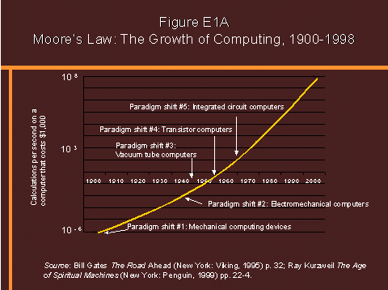
1.3
http://www.wadsworth.com/sociology_d/templates/student_resources
/0155072129_brym/chapter01/FigureE1A.gif

Slide 21
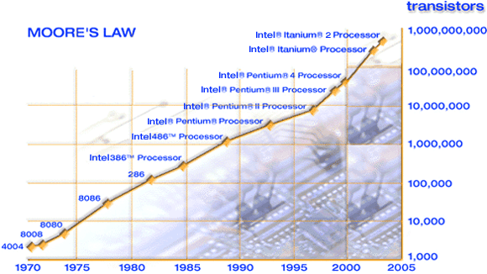
1.3
http://www.intel.com/research/silicon/images/MooresLawgraph3.gif

Slide 22
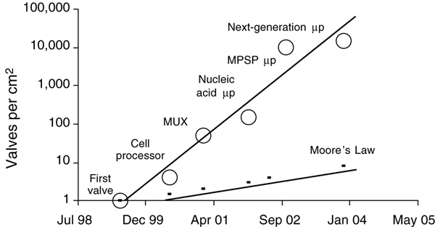
1.3
http://www.nature.com/nbt/journal/v21/n10/images/nbt871-F4.gif

Slide 23
Modern Parallel Computers
1.4
Caltech’s Cosmic Cube (Seitz and Fox)
Commercial copy-cats
  nCUBE Corporation
  Intel’s Supercomputer Systems Division
  Lots more
Thinking Machines Corporation

Slide 24
Copy-cat Strategy
1.4
Microprocessor
  1% speed of supercomputer
  0.1% cost of supercomputer
Parallel computer = 1000 microprocessors
  10 x speed of supercomputer
  Same cost as supercomputer

Slide 25
Why Didn’t Everybody Buy One?
1.4
Supercomputer ≠ Σ CPUs
  Computation rate ≠ throughput
  Inadequate I/O
Software
  Inadequate operating systems
  Inadequate programming environments

Slide 26
After the “Shake Out”
1.4
IBM
Hewlett-Packard
Silicon Graphics
Sun Microsystems

Slide 27
Commercial Parallel Systems
1.4
Relatively costly per processor
Primitive programming environments
Focus on commercial sales
Scientists looked for alternative

Slide 28
Beowulf Concept
1.4
NASA (Sterling and Becker)
Commodity processors
Commodity interconnect
Linux operating system
Message Passing Interface (MPI) library
High performance/$ for certain applications

Slide 29
Advanced Strategic Computing Initiative
1.4
U.S. nuclear policy changes
  Moratorium on testing
  Production of new weapons halted
Numerical simulations needed to maintain existing stockpile
Five supercomputers costing up to $100 million each

Slide 30
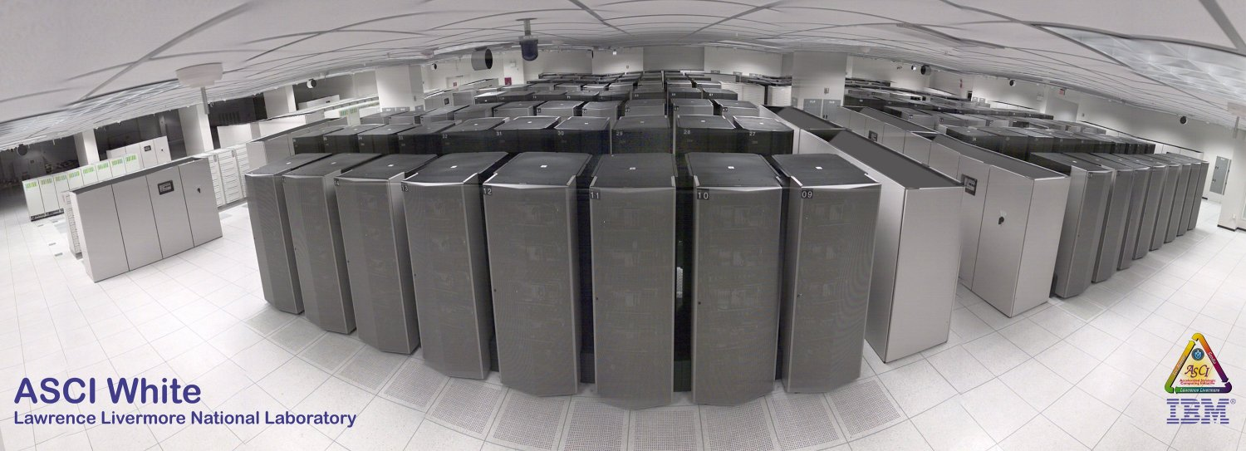
ASCI White (10 teraops/sec)
1.4

Slide 31
Seeking Concurrency
1.5
Data dependence graphs
Data parallelism
Functional parallelism
Pipelining

Slide 32
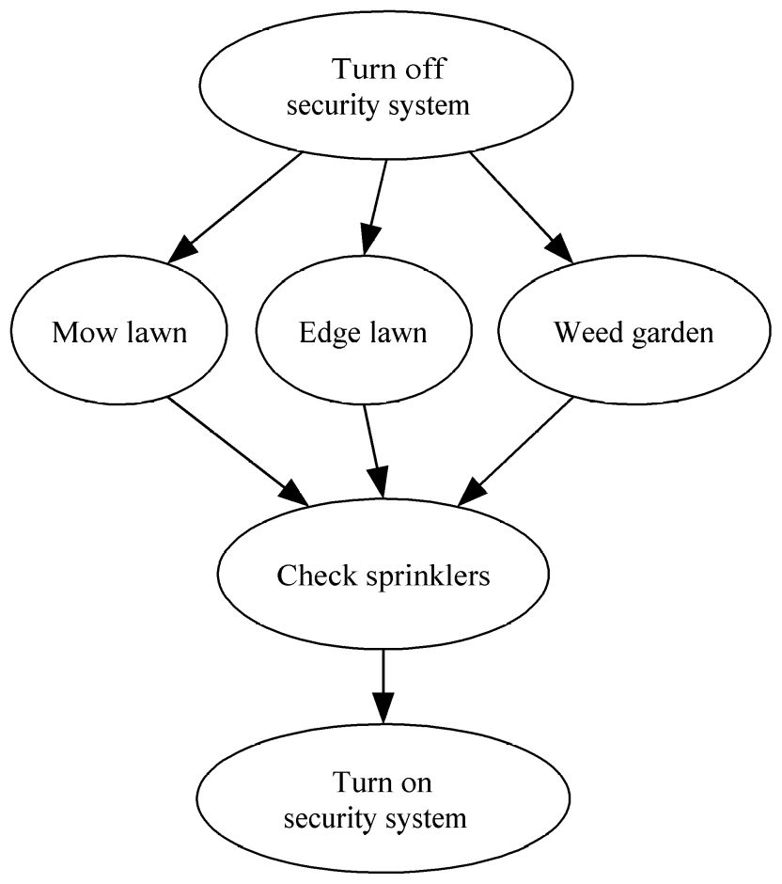
Data Dependence Graph
1.5
Directed graph
Vertices = tasks
Edges = dependences

Slide 33
Data Parallelism
1.5
Independent tasks apply same operation to different elements of a data set
Okay to perform operations concurrently
for i ← 0 to 99 do
a[i] ← b[i] + c[i]
endfor

Slide 34
Functional Parallelism
1.5
Independent tasks apply different operations to different data elements
First and second statements
Third and fourth statements
a ← 2
b ← 3
m ← (a + b) / 2
s ← (a² + b²) / 2
v ← s - m²

Slide 35
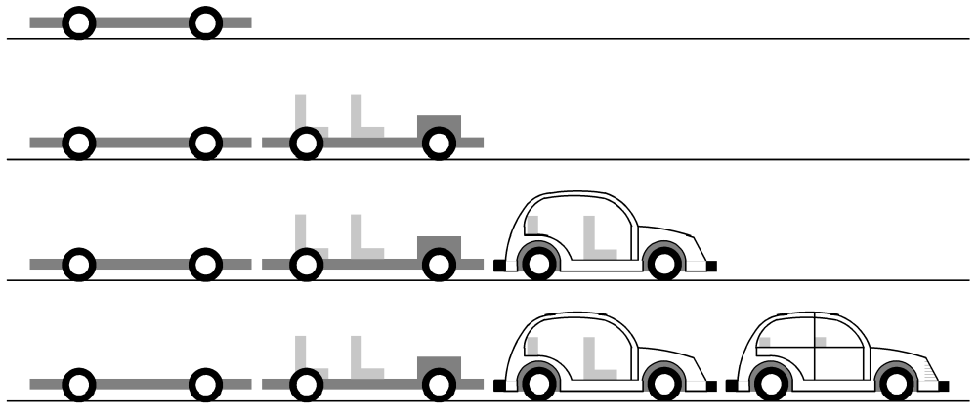
Pipelining
1.5
Divide a process into stages
Produce several items simultaneously

Slide 36
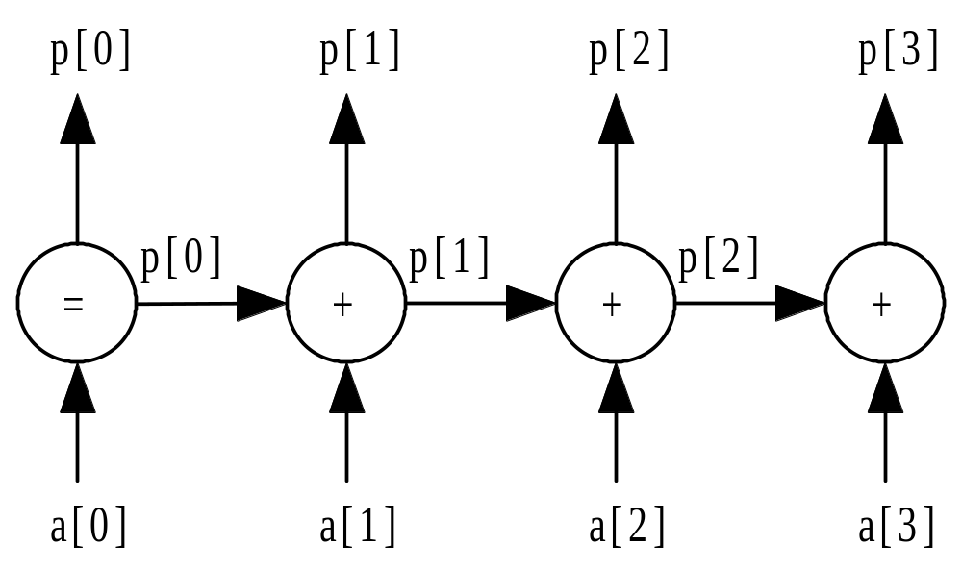
Partial Sums Pipeline
1.5
p[0] ← a[0]
for i ← 1 to 3 do
p[i] ← p[i-1] + a[i]
endfor

Slide 37
Data Clustering
1.6
Data mining
  looking for meaningful patterns in large data sets
Data clustering
  organizing a data set into clusters of “similar” items
Data clustering can speed retrieval of related items

Slide 38
Document Vectors
1.6
Moon
The Geology of Moon Rocks
The Story of Apollo 11
A Biography of Jules Verne
Alice in Wonderland
Rocket

Slide 39
Document Clustering
1.6

Slide 40
Clustering Algorithm
1.6
Compute document vectors
Choose initial cluster centers
Repeat
  Compute performance function
  Adjust centers
Until function value converges or max iterations have elapsed
Output cluster centers

Slide 41
Data Parallelism Opportunities
1.6
Operation being applied to a data set
Examples
  Generating document vectors
  Finding closest center to each vector
  Picking initial values of cluster centers

Slide 42
Functional Parallelism Opportunities
1.6
Draw data dependence diagram
Look for sets of nodes such that there are no paths from one node to another

Slide 43
Data Dependence Diagram
1.6
Build document vectors
Choose cluster centers
Compute function value
Adjust cluster centers
Output cluster centers

Slide 44
Programming Parallel Computers
1.7
Extend compilers: translate sequential programs into parallel programs
Extend languages: add parallel operations
Add parallel language layer on top of sequential language
Define totally new parallel language and compiler system

Slide 45
1. Extend Compilers
1.7
Parallelizing compiler
  Detect parallelism in sequential program
  Produce parallel executable program
Focus on making Fortran programs parallel

Slide 46
1. Extend Compilers (cont.)
1.7
Advantages
  Can leverage millions of lines of existing serial programs
  Saves time and labor
  Requires no retraining of programmers
  Sequential programming easier than parallel programming
Disadvantages
  Parallelism may be irretrievably lost when programs written in sequential languages
  Performance of parallelizing compilers on broad range of applications still up in air

Slide 47
2. Extend Language (Using API)
1.7
Add functions to a sequential language
  Create and terminate processes
  Synchronize processes
  Allow processes to communicate
Example
  PVM, MPI standard, OpenMP

Slide 48
2. Extend Language (cont.)
1.7
Advantages
  Easiest, quickest, and least expensive
  Allows existing compiler technology to be leveraged
  New libraries can be ready soon after new parallel computers are available
Disadvantages
  Lack of compiler support to catch errors
  Easy to write programs that are difficult to debug

Slide 49
3. Add a Parallel Programming Layer
1.7
Lower layer
  Core of computation
  Process manipulates its portion of data to produce its portion of result
Upper layer
  Creation and synchronization of processes
  Partitioning of data among processes
A few research prototypes have been built based on these principles – CODE, Hence

Slide 50
4. Create a Parallel Language
1.7
Develop a parallel language “from scratch”
  Erlang, occam is an example
Add parallel constructs to an existing language
  Fortran 90
  High Performance Fortran
  C*

Slide 51
4. New Parallel Languages (cont.)
1.7
Advantages
  Allows programmer to communicate parallelism to compiler
  Improves probability that executable will achieve high performance
Disadvantages
  Requires development of new compilers
  New languages may not become standards
  Programmer resistance

Slide 52
Current Status
1.7
Low-level approach is most popular
  Augment existing language with low-level parallel constructs
  MPI and OpenMP are examples
Advantages of low-level approach
  Efficiency
  Portability
Disadvantage: More difficult to program and debug

Slide 53
Summary (1/2)
High performance computing
  U.S. government
  Capital-intensive industries
  Many companies and research labs
Parallel computers
  Commercial systems
  Commodity-based systems

Slide 54
Summary (2/2)
Power of CPUs keeps growing exponentially
Parallel programming environments changing very slowly
Two standards have emerged
  MPI library, for processes that do not share memory
  OpenMP directives, for processes that do share memory

Slide 55
Exercise
1.10
1.13

